Slide 1
Dangers of SQL-I in real world applications
Don’t underestimate them…

Slide 2
Key points for today
What is SQL?
What are SQL Injections?
Why would I care?
Alright, I am scared. What should I do?

Slide 3
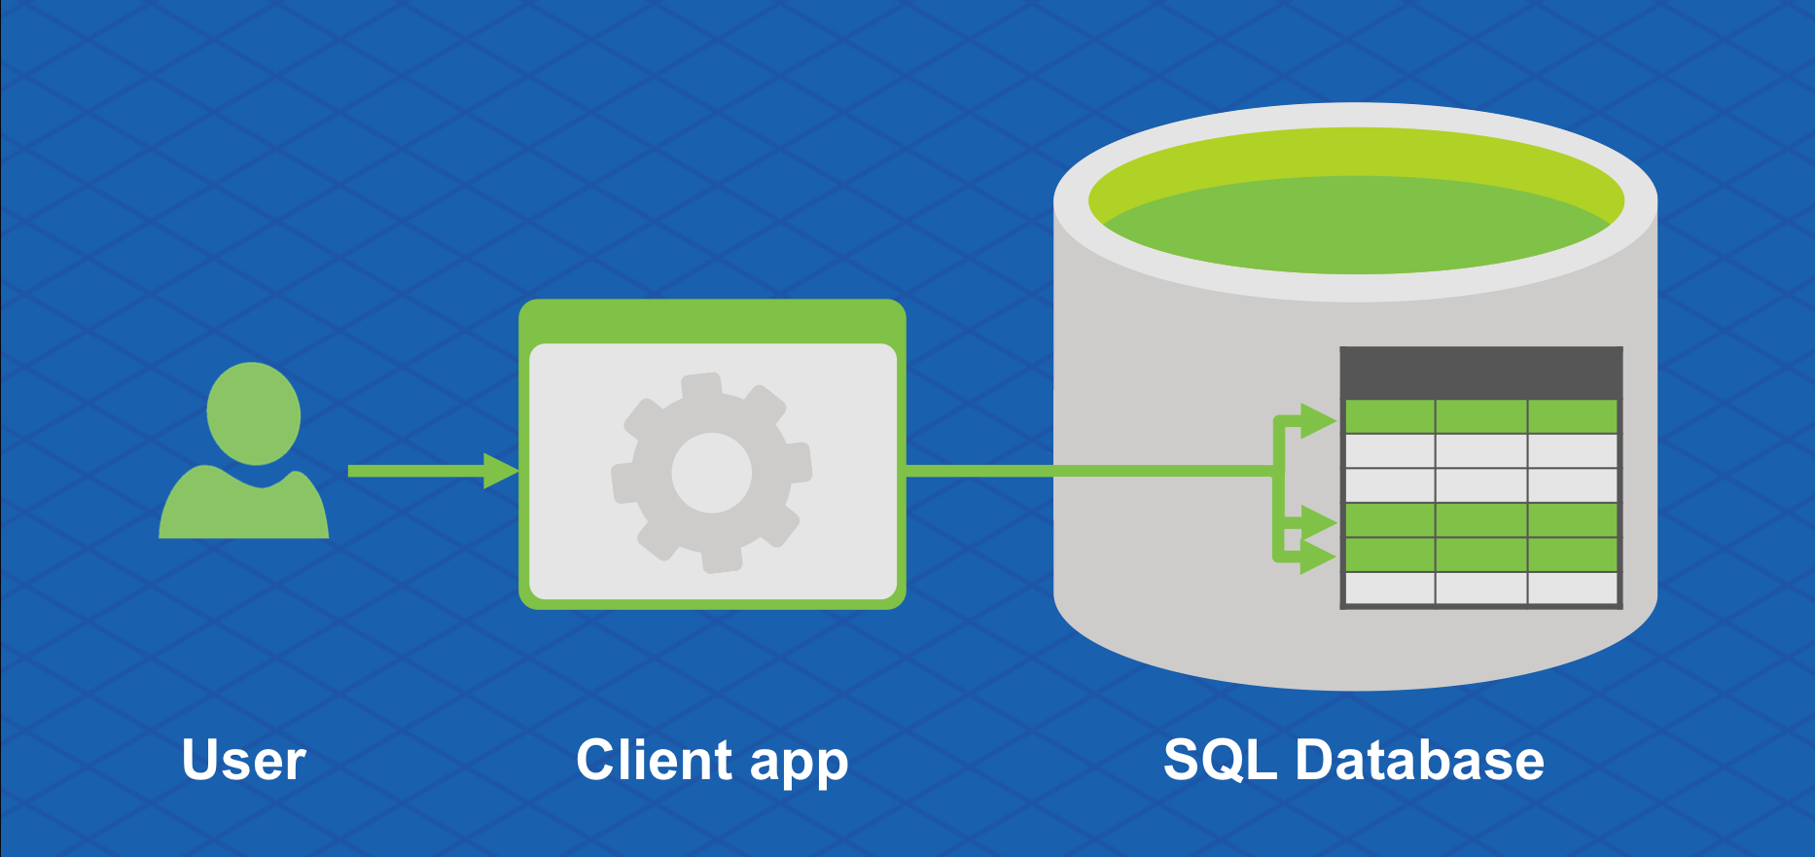
What is SQL?
SQL: Structured Query Language
Used to store, edit, and retrieve database data.
Applications issue SQL commands that manage data

Slide 4
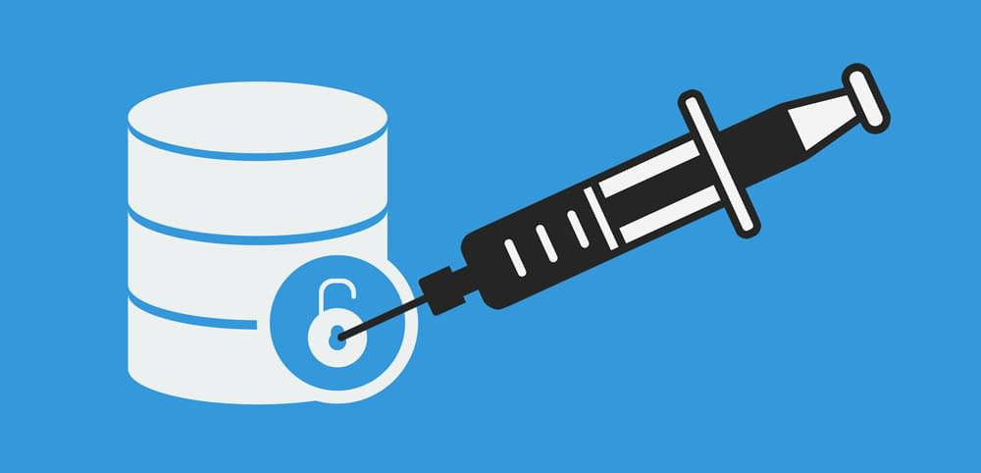
What are SQL’ Injections?
App sends form to user
Attacker send the form with SQL exploit data.
Application builds SQL query
Application sends query to server
Application returns data to user

Slide 5
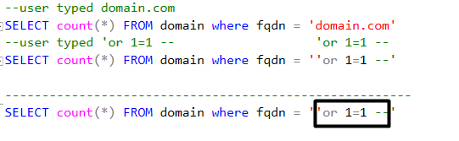
How does an SQL Injection looks like?

Slide 6
C’mon, how bad can it be?
Really, really bad.
On some cases, when the proper conditions are met, this SQL injection can do more than just grabbing your data.
MSSQL: xp_cmdshell
MYSQL: SELECT INTO OUTFILE ‘x.txt’
POSTGRESQL: COPY (SELECT) TO '/tmp/query.csv' (format csv, delimiter ';')

Slide 7
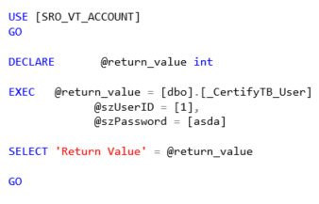
What can I do?
Always escape at least ‘
Use an ORM framework!
Use stored procedures (and enclose parameters with [])
DO NOT USE SA OR GIVE ADMIN RIGHTS TO YOUR APP!

Slide 8

Stay safe!
The world is a dangerous place, Elliott, not because of those who do evil, but because of those who look on and do nothing

